Slide 1
Machine Learning In 4 Days
Day 1 :
Introduction to Artificial Intelligence and Neural Network
Day 2 :
Python for beginner
Day 3:
Implementation of KNN for Hoda Handwriting
Day 4:
Convolution Neural Network ( CNN )

Slide 2
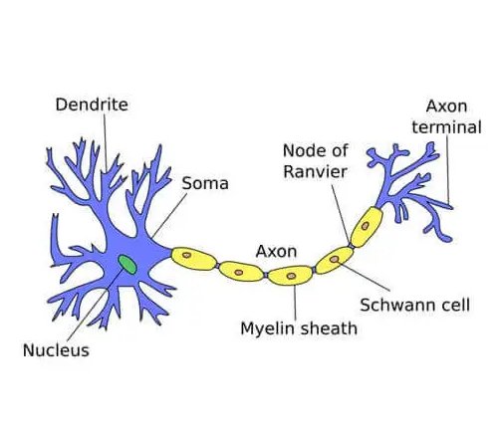

Slide 3
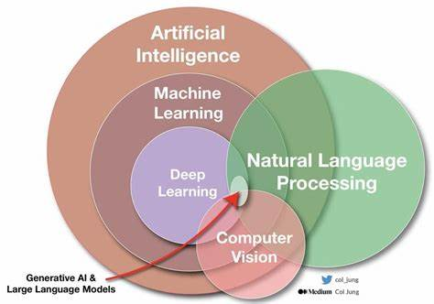

Slide 4
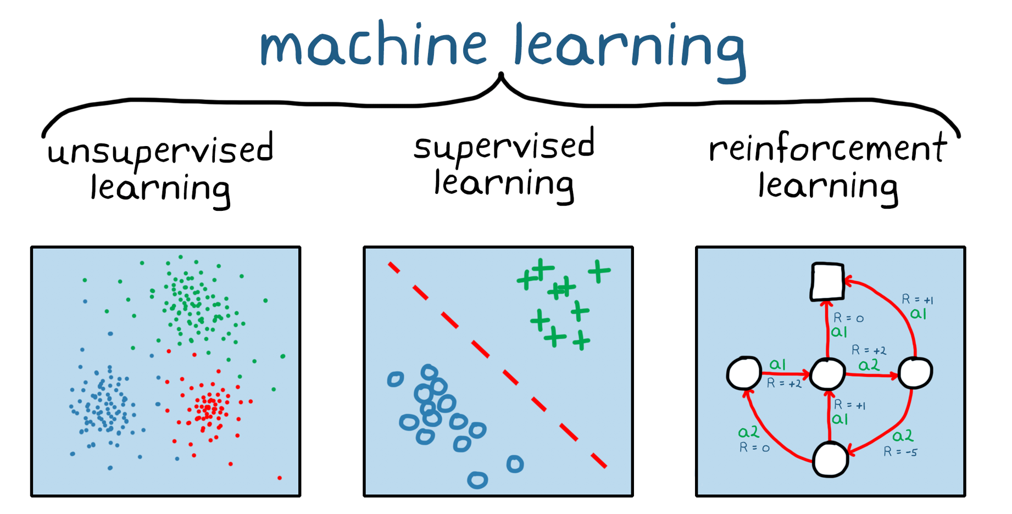
Machine Learning :
Supervised Learning
Classification – Categorical ( Dog – Cat )
Regression - contiguous ( House Cost )
Unsupervised Learning
Clustering ( anomaly Detection )
Reinforcement Learning
Agent and Environment
Action and Reward

Slide 5
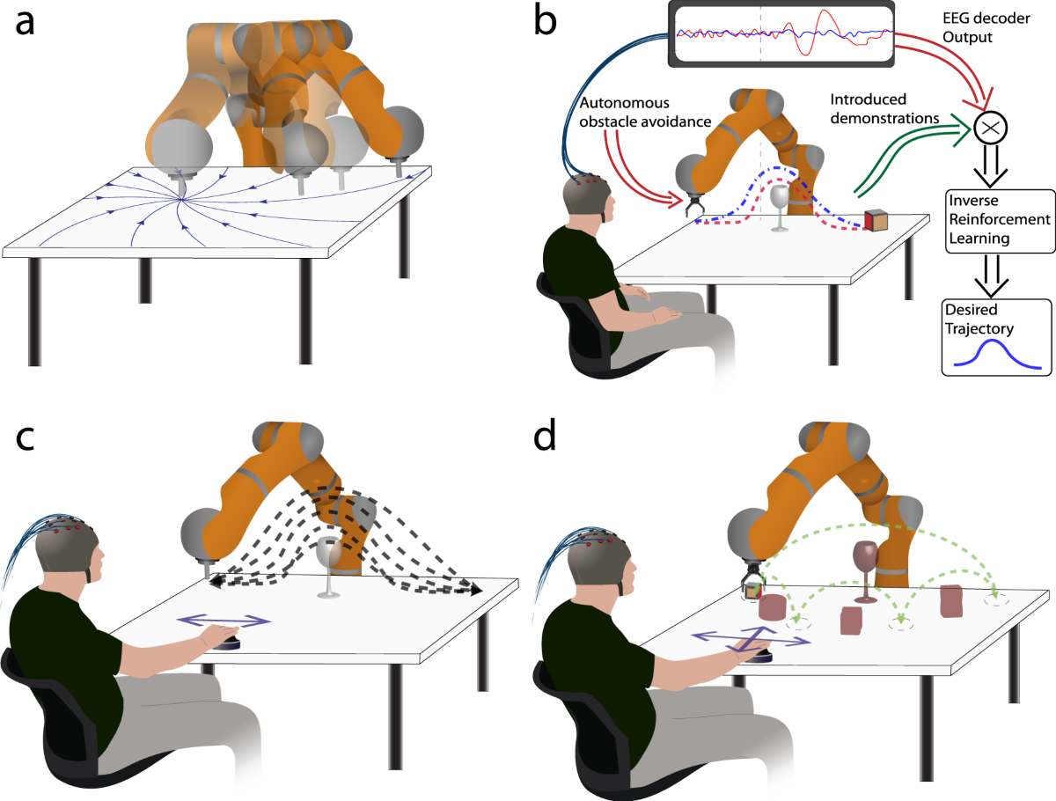
Reinforcement Learning

Slide 6
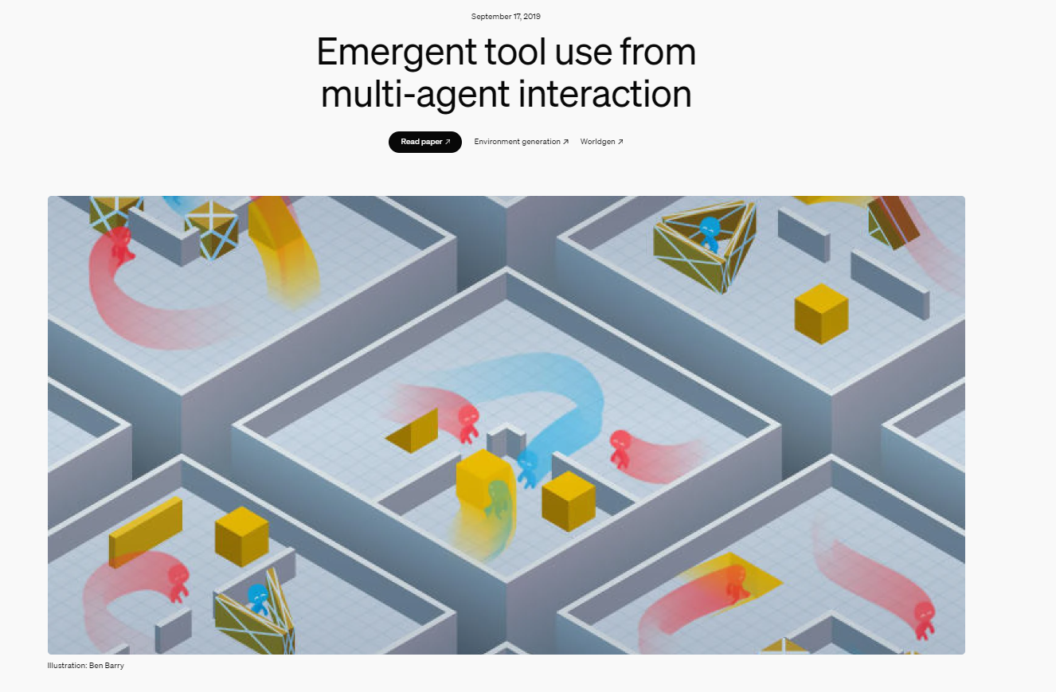
https://openai.com/index/emergent-tool-use/

Slide 7
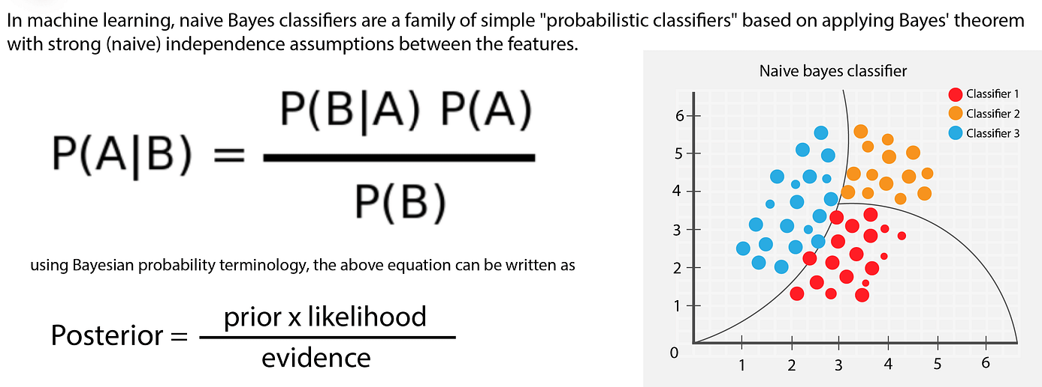
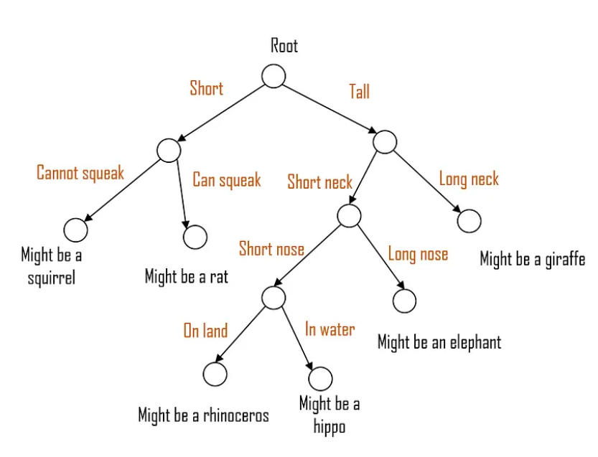
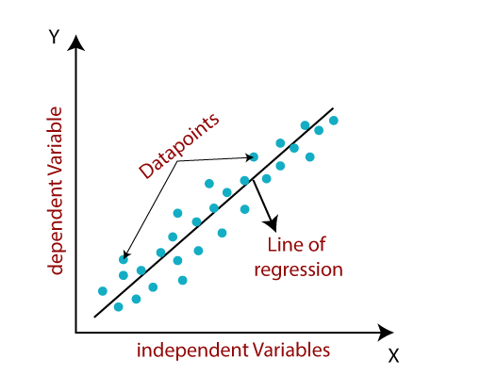
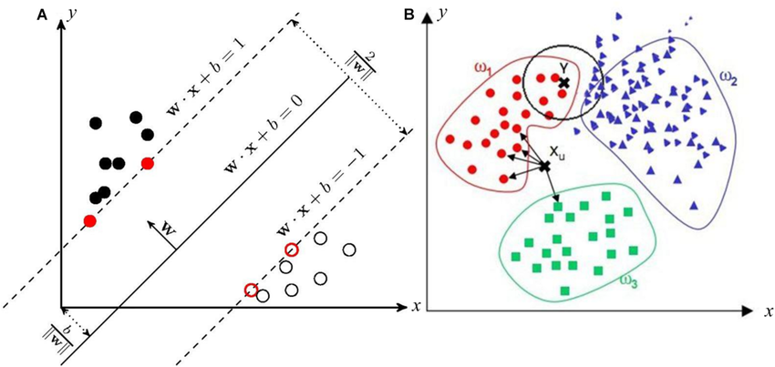
Traditional Neural Network
KNN ( K – Nearest Neighbor )
SVN ( Supper Vector Machine )
Liner Regression
Logistic Regression
Decision Tree
Naïve Bayesian Classifier

Slide 8
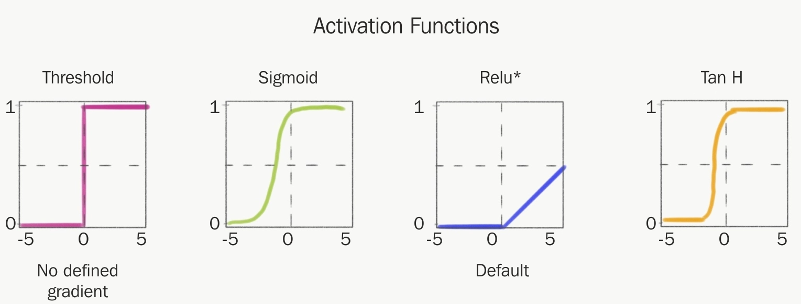
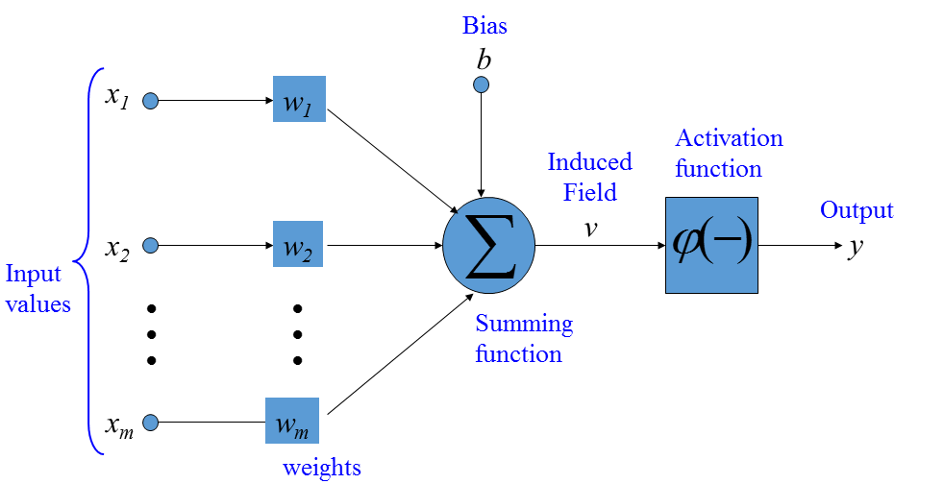
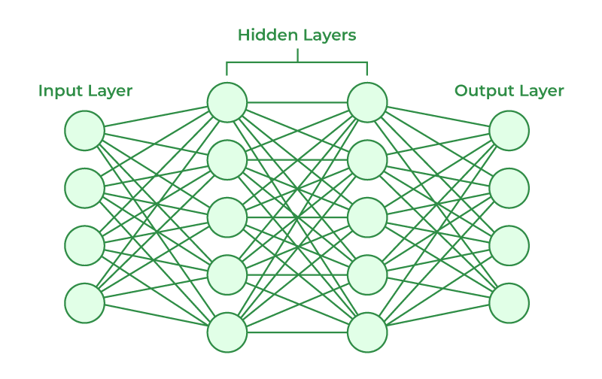
Natural Network
Fully Connected layer

Slide 9
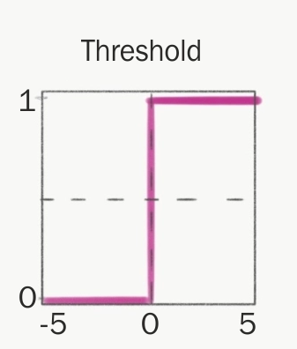
Perceptron
W1
X1
+
FEED FORWARD Network
AF
W2
X2
AF((X1*W1 + X2 * W2) + b )
b
bias
1
AF((0.8*0.3 + 0.9 * 0.2) + 1 ) = AF(5.2) = 1
AF((0.7*0.3 + 0.6 * 0.2) + 1 ) = AF(1.33) = 1
X1 | X2 | Result
0.8 | 0.9 | 1
0.7 | 0.6 | 1
0.3 | 0.2 | 0
AF((0.3*0.3 + 0.2 * 0.2) + 1 ) = AF(1.13) = 1
Error
0
0
1
w1 | w2
0.3 | 0.2

Slide 10
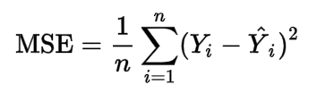
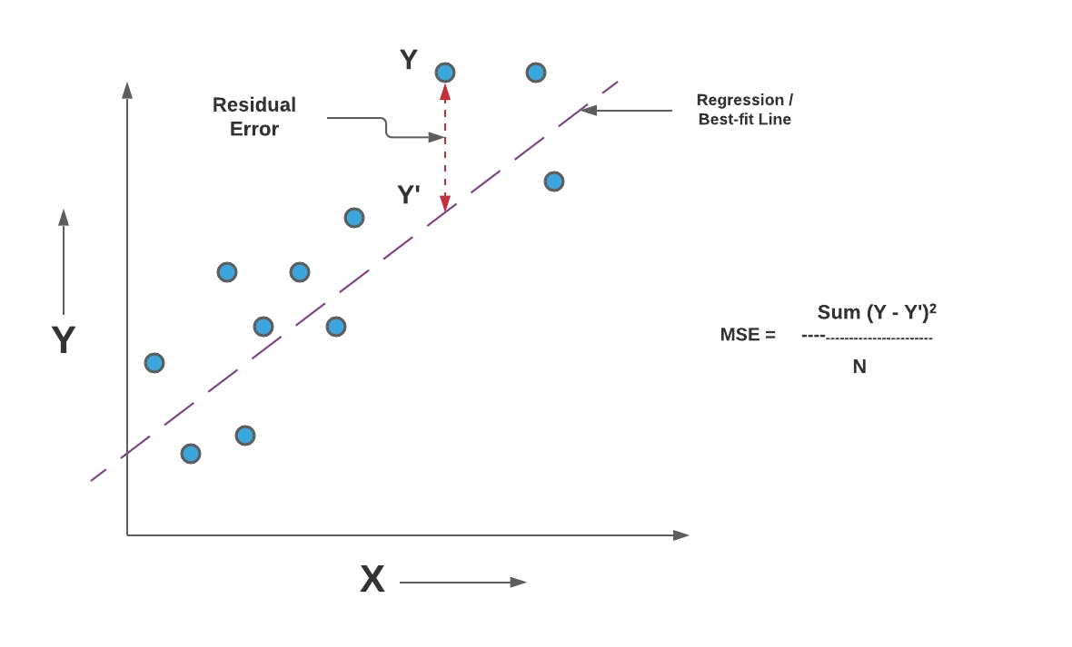
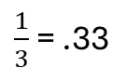
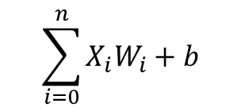
Loss Function and Back Propagation
X1
W1
Error
0
0
1
$\frac{1}{3}$ = .33
+
AF
Error
w1 | w2
0.3 | 0.2
X2
W2
b
.3 – (.3 * .33 )
.2 – (.2 * .33 )
Update
w1 | w2
0.201 | .134
$$\sum_{i=0}^{n}{X_{i}W_{i}+b}$$

Slide 11
bias
.5
0
+
AF
0
0
3
b
Changing the output of the perceptron regardless of the inputs and weights.
It is not received from the user
it will change during network training, just like the weights.
The bias functions as the intercept for the neural network.

Slide 12
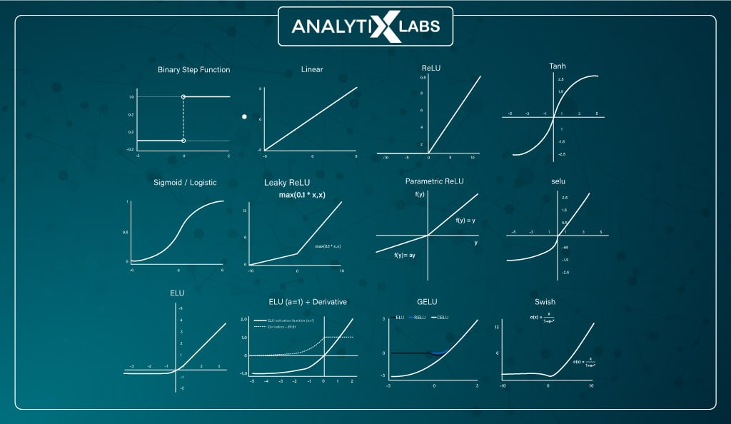
Activation Function | nonlinear functional
https://www.desmos.com/

Slide 13

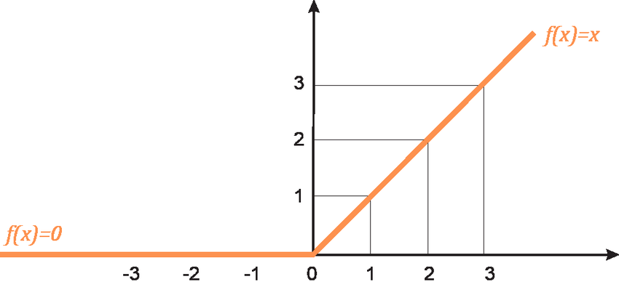
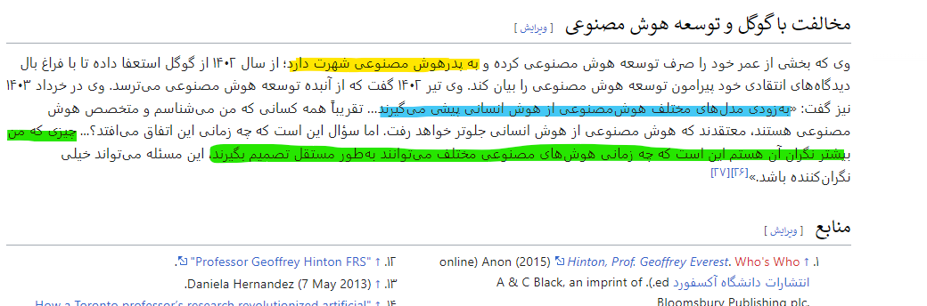
Start of Deep Learning
2008 (Geoffrey Everest Hinton)
ReLU (rectified linear unit )
Max(0,z)

Slide 14
Question
Should we assign an activation function to all perceptron's or not?
https://www.desmos.com/

Slide 15
K - Nearest Neighbor
K - Nearest Neighbor
If Noise appeared in data this algorithm is not efficient
If K = 1 this algorithm is not efficient
1-nn
3-nn

Slide 16
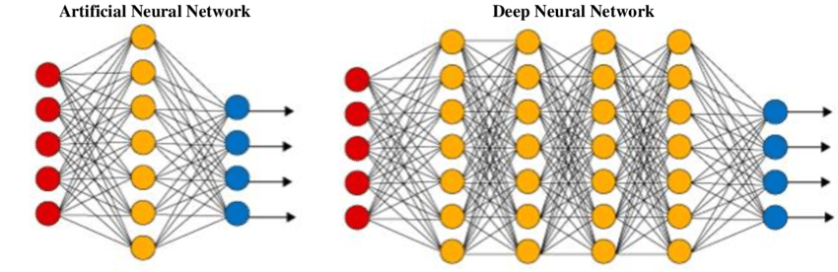
Neural Network Vs Deep Neural Network

Slide 17
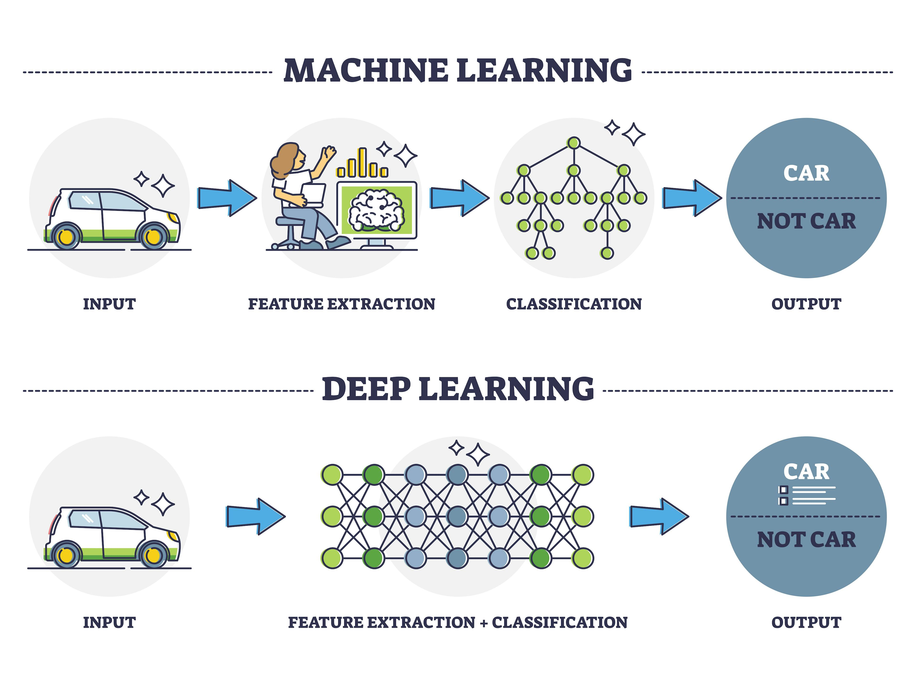
Machine Learning Vs Deep Learning

Slide 18
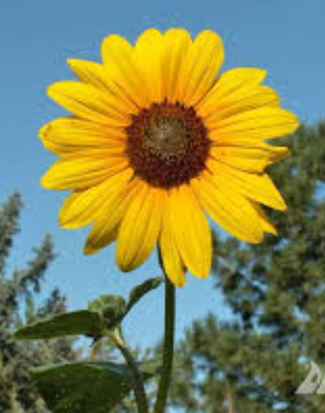

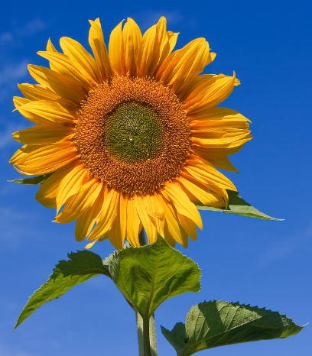
Are they different ?
If the criterion or features are the selection of pixels, these images are no longer equal.
Light
Form
Scale
Distance
Rotation
And ….

Slide 19
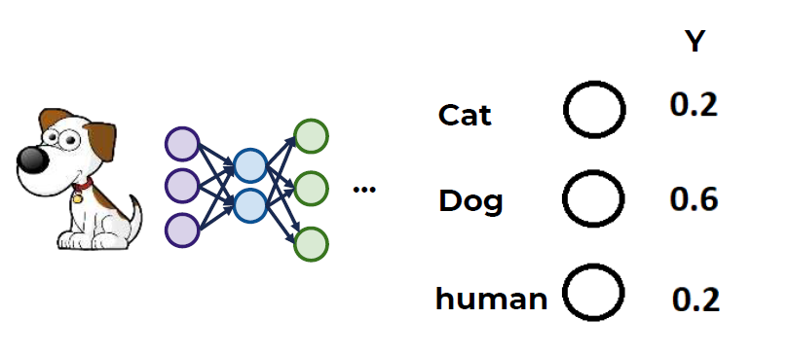
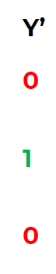
Cost Function
We know
Weight is Random
Bios is Random
One Hot label

Slide 20
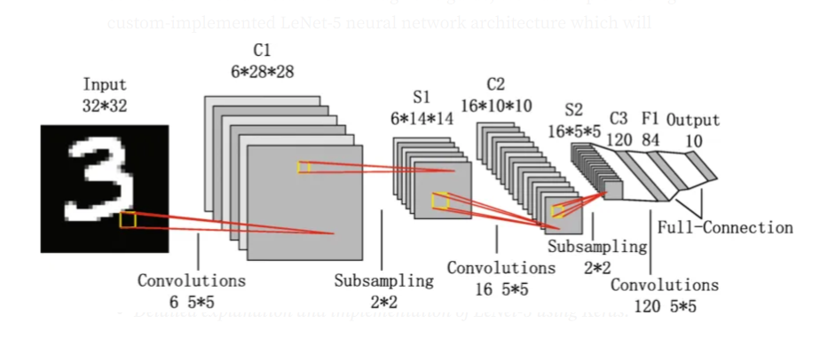
Deep Learning
Convolution Neural Network (CNN)
Recurrent Neural Network ( RNN )
Graph Neural Network (GNN)
Attention Network
Transformers
Large Language Model Neural Network ( LLM )

Slide 21
LetNet
alexNet
ResNet
Inception
Decoder-Encoder
GAN
Pix2Pix
Cycle GAN

Slide 22



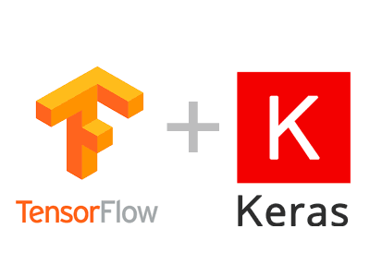



Requirements
Python
numpy
matplotlib
scikit-learn
pandas
Keras
TensorFlow | pyTorch
google colab

Slide 23
Slipping Data
Train Data
Test Data
Validation Data
Over fitting
Under fitting

